Slide 1
Unit - 4 NumPy
Numerical Python

Slide 2
Introduction
NumPy, short for Numerical Python, is the fundamental package required for high performance scientific computing and data analysis.
NumPy is the basis for SciPy and Pandas.
NumPy provides
ndarray, a fast and space-efficient multidimensional array providing vectorized arithmetic operations and sophisticated broadcasting capabilities
Standard mathematical functions for fast operations on entire arrays of data without having to write loops
Tools for reading / writing array data to disk and working with memory-mapped files
Functions for Linear algebra and statistics

Slide 3
ndarray: A multidimensional array object
An ndarray is a generic multidimensional container for homogeneous data; that is, all of the elements must be the same type.
Every array has a shape, a tuple indicating the size of each dimension, and a dtype, an object describing the data type of the array.

Slide 4
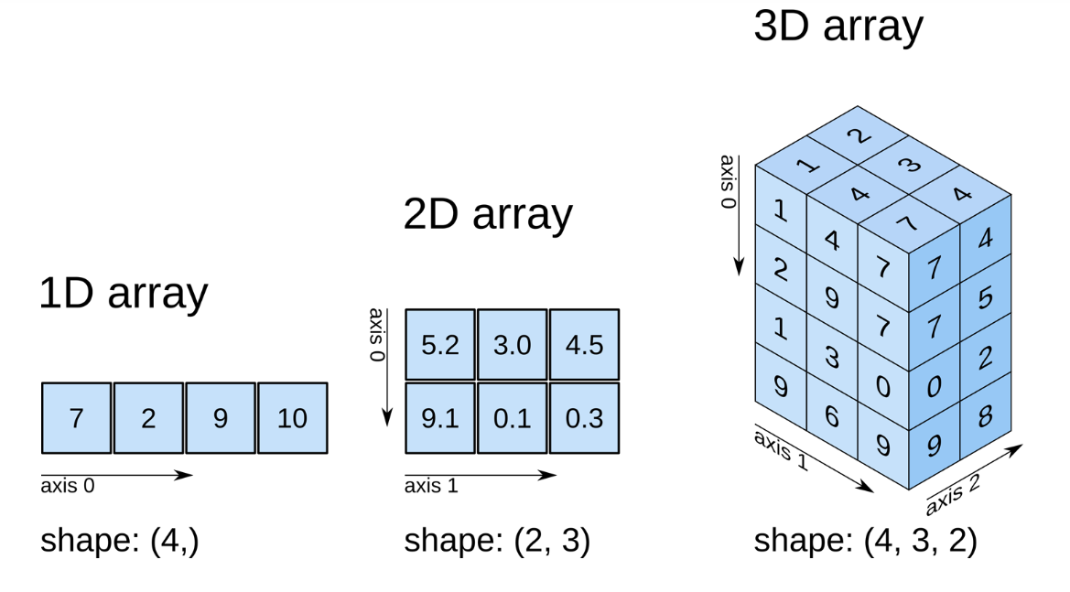
ndarray: A multidimensional array object

Slide 5
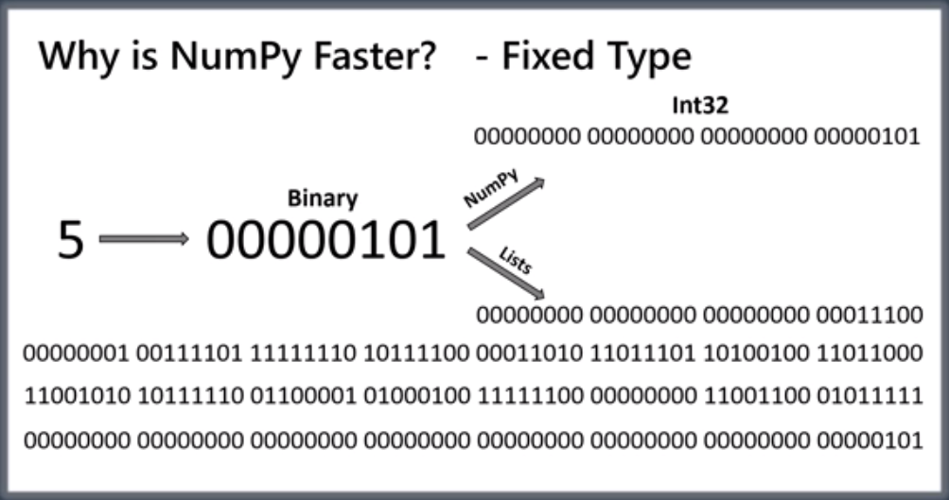
NumPy arrays are faster!
NumPy arrays are faster than Python lists.
NumPy uses fixed type.
4 bytes
28 bytes
Size
refCount
ObjType
ObjVal

Slide 6
NumPy arrays are faster!
NumPy arrays are allocated contiguous memory.
Lists are allocated memory that is not contiguous.
Python lists are resizable and can contain elements of different types.
NumPy arrays have fixed size at creation and contain fixed type data.
No type checking is required while iterating through NumPy arrays.

Slide 7
NumPy allows lot more operations apart from insertion, deletion, append, concatenation.
List
a = [1,2,3]
b = [4,5,6]
a*b is an error
NumPy Array
a = np.array([1,2,3])
b = np.array([4,5,6])
a*b returns
array([ 4, 10, 18])

Slide 8
Creating NumPy arrays
numpy.array(object, dtype=None,..)
a=np.array([1,2,3])
Creates a vector
b=np.array([[1,2,3],[4,5,6],[7,8,9]])
Creates a 3x3 array
numpy.arange([start, ]stop, [step, ]dtype=None)
c = np.arange(10)
Creates a vector: ([0,1,2,3,4,5,6,7,8,9])
c = np.arange(1,10)
Creates a vector: ([1, 2, 3, 4, 5, 6, 7, 8, 9])

Slide 9
Attributes of NumPy array
Get dimension:
ndarray.ndim
ndim represents the number of dimensions (axes) of the ndarray
a.ndim --> 1
b.ndim --> 2
Get shape:
ndarray.shape
shape is a tuple of integers representing the size of the ndarray in each dimension.
a.shape --> (3,)
b.shape --> (3, 3)
Get type:
ndarray.dtype
dtype tells the data type of the elements of a NumPy array. In NumPy array, all the elements have the same data type.
a.dtype --> dtype('int32')
b.dtype --> dtype('int32')

Slide 10
Attributes of NumPy array
Get number of elements:
size is the total number of elements in the ndarray. It is equal to the product of elements of the shape.
a.size --> 3
b.size --> 9
Get size:
itemsize returns the size (in bytes) of each element of a NumPy array.
a.itemsize --> 4
d = np.array([1,2,3], dtype='int16')
d.itemsize --> 2
c = np.array([1,2,3,4], dtype='float')
c.itemsize --> 8
Get total size:
a.itemsize * a.size
a.nbytes is same as above

Slide 11
Accessing/Changing specific elements, rows, columns etc
Get a specific element [r,c]:
a = np.array([[1,2,3,4,5,6,7],[8,9,10,11,12,13,14]])
a[1,5] returns 13 (same as a[1,-2])
a[0] returns array([1,2,3,4,5,6,7])
a[:, 2] returns array([3,10])
Getting slice [startindex, stopindex, step]
a[0,1:6:2] returns array([2,4,6]) (same as a[0,1:-1:2])
a[:,1:6:2] returns
[[ 2, 4, 6]
[9, 11, 13]]
Changing values
a[1,5]=20 changes element 13 to 20
a[:,2]=20 Changes third column of each row to 20
a[:,2]=[10,20] changes third column of first row to 10 and third column of second row to 20

Slide 12
Initializing different types of arrays
All zeros matrix:
np.zeros(5) returns array([0.,0.,0.,0.,0.])
np.zeros(3,3) returns a 3X3 matrix with all zeros
All ones matrix:
np.ones(3,3) returns a 3X3 matrix with all ones
Matrix with some specific number:
np.full((3,3), -1) returns a 3X3 matrix with all -1s
Matrix with same shape as another but with some specific number:
a = np.array([[1,2,3,4,5,6,7],[8,9,10,11,12,13,14]])
b = np.full_like(a,99) returns
array([[99, 99, 99, 99, 99, 99, 99],
[99, 99, 99, 99, 99, 99, 99]])

Slide 13
Initializing different types of arrays
Create a matrix of random numbers:
c = np.random.rand(4,2) returns a 4X2 matrix with random decimal numbers
c = np.random.randint(1,10,size=(3,3), dtype='int16’)
returns a 3X3 matrix with random integers in range 1 to 10 (exclusive)
c = np.random.randint(10,size=(3,3), dtype='int16') returns a 3X3 matrix with elements in the range 0 to 10(exclusive)
Creating identity matrix:
np.identity(4) returns A 4X4 Identity matrix

Slide 14
Initializing different types of arrays
Repeat an array to create a 2D array
a = np.array([[1,2,3]]) returns an array of shape (1,3)
To create a 3X3 array with repeating elements of a, we can write:
b = np.repeat(a,3,axis=0) returns
array([[1, 2, 3],
[1, 2, 3],
[1, 2, 3]])
b = np.repeat(a,3,axis=1) returns
array([[1, 1, 1, 2, 2, 2, 3, 3, 3]])
By default axis=1 if omitted

Slide 15
Be careful while copying one array to another!
a = np.array([1,2,3,4,5])
b = a
b[1]=99
a also changes, because b is a reference of a, not a different array.
b = copy.deepcopy(a)
b is a different array that has the same values as a
We can also use
b = a.copy()
b is a different array that has the same values as a

Slide 16
Vertically stacking arrays
v1 = np.array([1,2,3,4])
v2 = np.array([5,6,7,8])
To stack v1 on top of v2
v3 = np.vstack([v1, v2]) returns
[[1, 2, 3, 4],
[5, 6, 7, 8]]
v3 = np.vstack([v1,v2,v1,v2]) returns
[[1, 2, 3, 4],
[5, 6, 7, 8],
[1, 2, 3, 4],
[5, 6, 7, 8]]

Slide 17
Horizontally stacking arrays
h1=np.ones((2,4))
array([[1., 1., 1., 1.],
[1., 1., 1., 1.]])
h2=np.zeros((2,2))
array([[0., 0.],
[0., 0.]])
If we want h2 to be to the right of h1:
h3=np.hstack([h1,h2])
array([[1., 1., 1., 1., 0., 0.],
[1., 1., 1., 1., 0., 0.]])

Slide 18
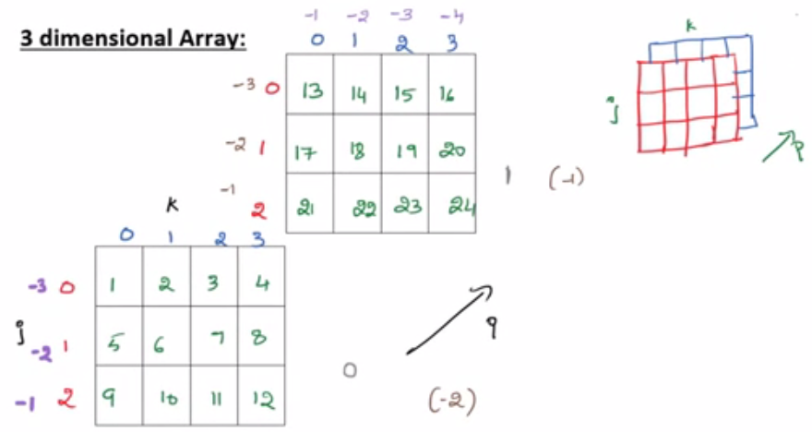
3-Dimensional Arrays
3-D array is basically a 2-D array within an array.d
np.arange(1,25).reshape(2,3,4)

Slide 19
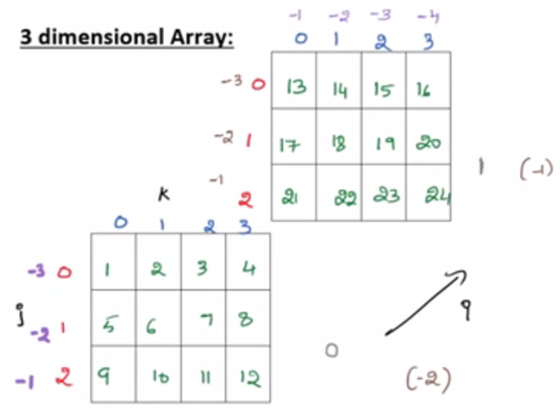
Indexing 3-D arrays
To access 2, we can write:
a[0][0][1] or a[-2 ][-3][-3]
To access 16, we can write:
a[1][0][3] or a[-1][-3][-1]
What does a[0] return?
What does a[0][1] returns?

Slide 20
Slicing 3-D arrays
For slicing 1-D arrays, we used [start:stop:step] and for slicing 2-D array, we used [start:stop:step, start:stop:step].
To slice 3-D arrays, we use:
[start:stop:step, start:stop:step, start:stop:step]
i
j
k

Slide 21
Slicing 3-D arrays
array([[[ 1, 2, 3, 4],
[ 5, 6, 7, 8],
[ 9, 10, 11, 12]],
[[13, 14, 15, 16],
[17, 18, 19, 20],
[21, 22, 23, 24]]])
To slice the 3-D array as shown, we write:
a[:, :, 0:1]
array([[[ 1, 2, 3, 4],
[ 5, 6, 7, 8],
[ 9, 10, 11, 12]],
[[13, 14, 15, 16],
[17, 18, 19, 20],
[21, 22, 23, 24]]])
To slice the 3-D array as shown, we write:
a[:, 1:, 0::2]

Slide 22
Advanced Indexing
Indexing and slicing are together called Basic Indexing in NumPy.
Using basic indexing, we can access a particular element (integer index) or a group of particular elements in an array (slice).
In advanced indexing, we can use an ndarray as an index.
The ndarray should be of either integer type (Integer Indexing) or Boolean type (Boolean Indexing).

Slide 23
Example for Integer Indexing
a=np.arange(1,10) returns array([1, 2, 3, 4, 5, 6, 7, 8, 9])
If we want to access the highlighted elements:
Create array of index
index = np.array([1,4,5])
Use index array as index
a[index] returns array([2, 5, 6])
If you don't want to create arrays, you can use list also, because in advanced indexing, you can use list as index because list is a sequence:
a[[1,4,5]] also returns array([2, 5, 6])

Slide 24
Advanced Indexing
b=np.arange(1,10).reshape(3,3)
array([[1, 2, 3],
[4, 5, 6],
[7, 8, 9]])
To retrieve highlighted elements:
b[[0,2],[2,0]]
b=np.arange(1,10).reshape(3,3)
array([[1, 2, 3],
[4, 5, 6],
[7, 8, 9]])
To retrieve highlighted elements:
b[[1,1,2],[0,2,1]]
Using advanced indexing, we can access elements repeatedly:
a=np.arange(1,10)
a[[1,4,1,4,1,4] returns array([2, 5, 2, 5, 2, 5])

Slide 25
Boolean Indexing
Here, instead of integer, we use Boolean expression as the index.
The elements that satisfy the Boolean expression are returned.
For example, assume we have IA marks scored by 5 students in three tests stored in an array:
a=np.random.randint(1,31,size=(5,3))
If we want to add 3 to all the marks that are less than 15, we write:
a[a<15]+=3

Slide 26
Boolean Indexing
Assume we have temperature of 10 cities recorded as an array:
a=np.random.randint(10,40,size=(10,))
array([12, 38, 35, 31, 21, 28, 25, 39, 17, 31])
To find temperatures more than 25 degree:
a[a>25] returns array([38, 35, 31, 28, 39, 31])
a>25 returns the following:
array([False, True, True, True, False, True, False, True, False, True])

Slide 27
Array Manipulation (transpose and swapaxes functions)
numpy.transpose(array, axes=None)
transpose() rearranges the dimension of the given NumPy array in the reverse order.
Doesn’t copy the resulting array but returns a view of the resulting array.
a1 = np.arange(1,11).reshape(5,2)
np.transpose(a1) will return array of shape(2,5)
We can also write as
a1.transpose() or
a.T

Slide 28
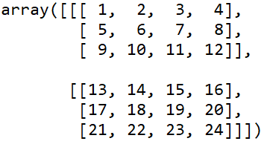
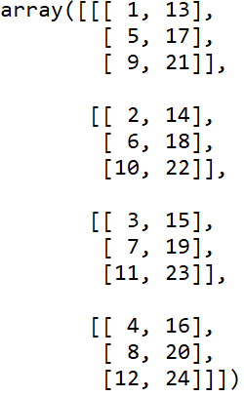
Transposing 3-D Arrays
a = np.arange(1,25).reshape(2,3,4)
Shape is (2,3,4)
np.transpose(a)
Shape is (4,3,2)
transpose() has no effect on 1-D arrays as 1-D arrays have single dimension

Slide 29
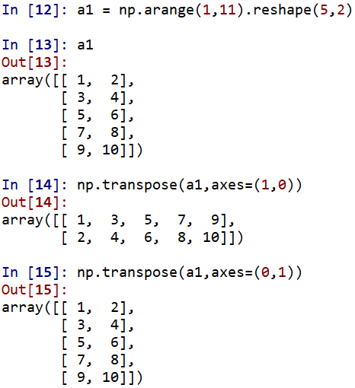
The axes() parameter
axes=(1,0) or (0,1)
reverse
same
np.transpose(a1)

Slide 30
The axes() parameter
a=np.arange(1,25).reshape(2,3,4)
Creates a 3-D array whose shape is (2,3,4)
If we transpose array a, we get a 3-D array of shape (4,3,2) as we have seen earlier.
If we want to transpose it to get a (3,4,2) array, the axes parameter comes into picture:
np.transpose(a,1,2,0)
This is shown in next slide.

Slide 31
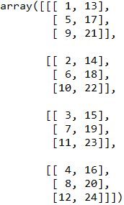
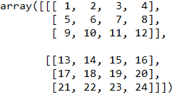
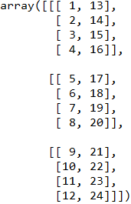
shape(4,3,2)
np.transpose(a)
shape(2,3,4)
np.transpose(a)
shape(3,4,2)
If we don’t specify axes parameter, transpose function by default will rearrange the dimensions in the reverse order.

Slide 32
swapaxes()
swapaxes(array, axis1, axis2)
swapaxes() is used to interchange the axes of an array (axis1 is swapped with axis2).
Example:
a=np.array([[1,2,3]]) → shape is (1,3)
np.swapaxes(a,0,1) returns an array of shape (3,1)
array([[1],
[2],
[3]])

Slide 33
Example for swapaxes()
a=np.array([[1,2],[3,4]])
array([[1, 2],
[3, 4]])
np.swapaxes(a,0,1)
First row becomes first column and second row becomes second column.
array([[1, 3],
[2, 4]])
np.swapaxes(a,1,0)

Slide 34
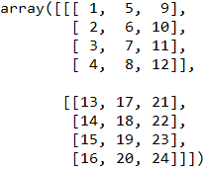
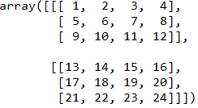
Example for swapaxes()
a=np.arange(1,25).reshape(2,3,4)
If we want to swap row and column of each 2-D array,
np.swapaxes(a,1,2)
shape(2,3,4)
shape(2,4,3)

Slide 35
NumPy Mathematics
NumPy provides standard trigonometric functions, functions for arithmetic operations, handling complex numbers, etc.
a=np.array([1,2,3,4])
b=np.array([1,1,1,1])
Following operations are permissible:
a+b, a+2, a-3, a*2, a/2, a**2, a += b, a-=1
np.sin(a) returns sine values of each element
np.cos(a) returns cosine valus of each element
np.exp(a) calculates exponential of all the elements
np.log(a) calculates Natural logarithm of all elements
a=np.array([0.5,1.5,2.5,3.5,4.5])
np.around(a) evenly rounds the array elements
np.ceil(a), np.floor(a), np.trunc(a) …
np.reciprocal(a) returns reciprocal of array elements
np.divide(arr1, arr2) same as arr1/arr2

Slide 36
Linear Algebra using NumPy
The Linear Algebra module of NumPy offers various methods to apply linear algebra on any numpy array.
Using NumPy we can find:
rank, determinant, trace, etc. of an array.
eigen values of matrices
matrix and vector products (dot, inner, outer product), matrix exponentiation
solve linear or tensor equations and much more!

Slide 37
Linear Algebra using NumPy
NumPy mathematics is performed element-wise. Linear algebra is done on the entire matrix.
For example:
a = np.ones((2,3))
b = np.full((3,2),2)
Matrix multiplication:
np.matmul(a,b) returns
[[6,6]
[6,6]]
Find determinant:
c = np.identity(3)
np.linalg.det(c) returns 1
Similarly, we can find rank, norm, Eigen values, inverse, trace etc of a matrix.

Slide 38
Statistics with NumPy
NumPy has useful statistical functions for finding minimum, maximum, percentile standard deviation and variance, etc from the given elements in the array.
a=np.array([[1,2,3],[4,5,6]])
np.min(a)
np.max(a)
np.min(a, axis=1) returns minimum in each row as array([1, 4])
np.sum(a) returns sum of all the elements
np.sum(a, axis=0) returns sum of each column
np.sum(a, axis=1) returns sum of each row

Slide 39
a=np.array([1,2,3,4,5,6,7,8,9,10])
np.min(a) returns 1
np.max(a) returns 10
np.mean(a) returns 5.5
np.median(a) returns 5.5
np.std(a) returns 2.8722813232690143

Slide 40
Reading data from a file
f =np.genfromtxt("data.txt", delimiter=',').astype('int16')
f is an array as below:
array([[ 1, 2, 3, 4, 5, 6, 7, 8, 9, 10],
[ 11, 22, 33, 44, 55, 66, 77, 88, 99, 100],
[ 23, 34, 45, 56, 67, 78, 89, 98, 210, 120],
[ 54, 23, 67, 12, 88, 43, 33, 74, 41, 69]], dtype=int16)

Slide 41
Boolean masking and advanced indexing
f>20 -->
array([[False, False, False, False, False, False, False, False, False, False],
[False, True, True, True, True, True, True, True, True, True],
[ True, True, True, True, True, True, True, True, True, True],
[ True, True, True, False, True, True, True, True, True, True]])
We can also index where the condition satisfies to get only those values:
You can also index where the condition satisfies to get only those values:
f[f>20] returns
array([ 22, 33, 44, 55, 66, 77, 88, 99, 100, 23, 34, 45, 56,
67, 78, 89, 98, 210, 120, 54, 23, 67, 88, 43, 33, 74,
41, 69], dtype=int16)
As can be seen in above example, in NumPy we can index with a list.

Slide 42
f = np. array([[ 1, 2, 3, 4, 5, 6, 7, 8, 9, 10],
[ 11, 22, 33, 44, 55, 66, 77, 88, 99, 100],
[ 23, 34, 45, 56, 67, 78, 89, 98, 210, 120],
[ 54, 23, 67, 12, 88, 43, 33, 74, 41, 69]])
We can also form compound conditional just as in Python,
((f>10) & (f<80)) returns
array([[False, False, False, False, False, False, False, False, False, False],
[ True, True, True, True, True, True, True, False, False, False],
[ True, True, True, True, True, True, False, False, False, False],
[ True, True, True, True, False, True, True, True, True, True]])

Slide 43
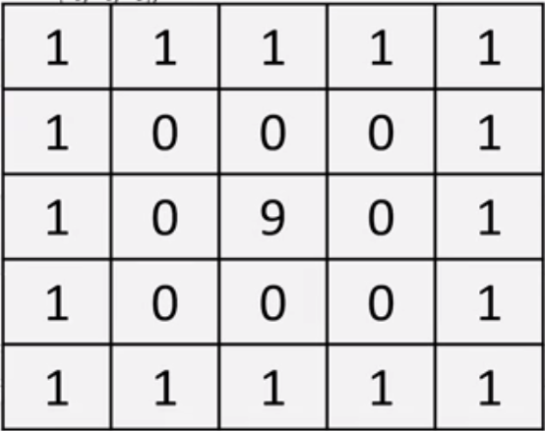
Write NumPy statements to create this array

Slide 44
Solution
a=np.ones((5,5))
a[1:4,1:4]=0
a[2,2]=9
a=np.ones((5,5))
b=np.zeros((3,3))
b[1,1]=9
a[1:4,1:4]=b

Slide 45
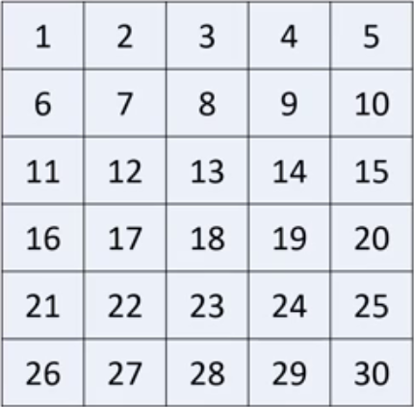
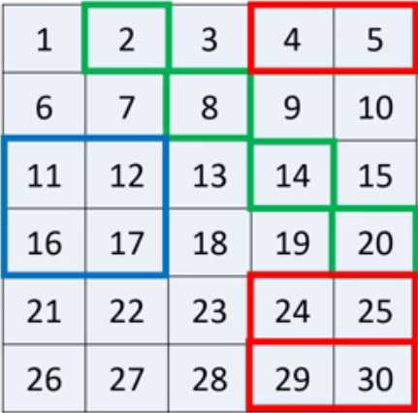
How do you index the part of the matrix shown in different colors?

Slide 46
Solution
a[2:4, 0:2]
a[[0,1,2,3], [1,2,3,4]]
a[[0,4,5],3:]

